Slide 1
All About Content
Presented by: Adejayan Ebunoluwa
Last Updated: June 15th, 2022

Slide 2
Today’s Agenda
Project Recap
Problem
Objective
Insights
Conclusion

Slide 3
Project Recap
Firstly, we appreciate you for trusting us with this project and knowing that you want the best team on this project which we are capable of. We therefore agreed to;
Carrying out an audit of your big data practice and sharing the best practices in the industry.
Guiding you through a successful IPO of which we have a deep understanding of because we have the best within the team.
And finally, we the data analytic team will be running an analysis of your top five(5) content categories with the largest popularity.

Slide 4
Problem
Due to your user’s growth, you made it known that;
1. The management,
2. Extraction and
3. Analysis of big data is fast proving difficult for you to handle
And we understand it’s not just about the user’s growth, but providing to
your audience a more personalized and enjoyable experience. This is where
our expertise comes in with the insights we have uncovered from this project.

Slide 5
PROCESS
1
Data Understanding
4
Analyzed the data and uncovered necessary insights and made it easy to understand by creating visuals
2
Data Extraction
5
3
Recommendations
Modelling and Cleaning of the data

Slide 6

For the past one year, Social Buzz has released 1000 contents cutting
across 16 categories and has grew up users by 500. Out of the
1000 contents, 962 contents was posted by 438 users giving a total of
24,573 reactions.
Such a number isn’t it? That is over a 90% of your users giving out
wonderful contents. This really proves that you are having a real time
users engagement

Slide 7
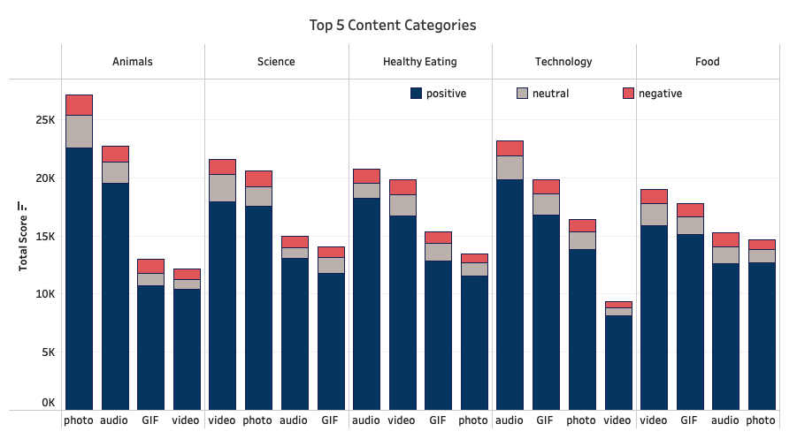
Answering the main question, by comparison, all categories are doing well.
But here are the top five(5) popular categories Social Buzz has seen more of positive reactions on.
“Animal content” was the highest with a total reaction of 1897 which means people reacted more to animal related posts. Specifically a photo type as we can look to the left.
There’s also more of a positive vibes around these content than negative vibes which is a good thing right?

Slide 8
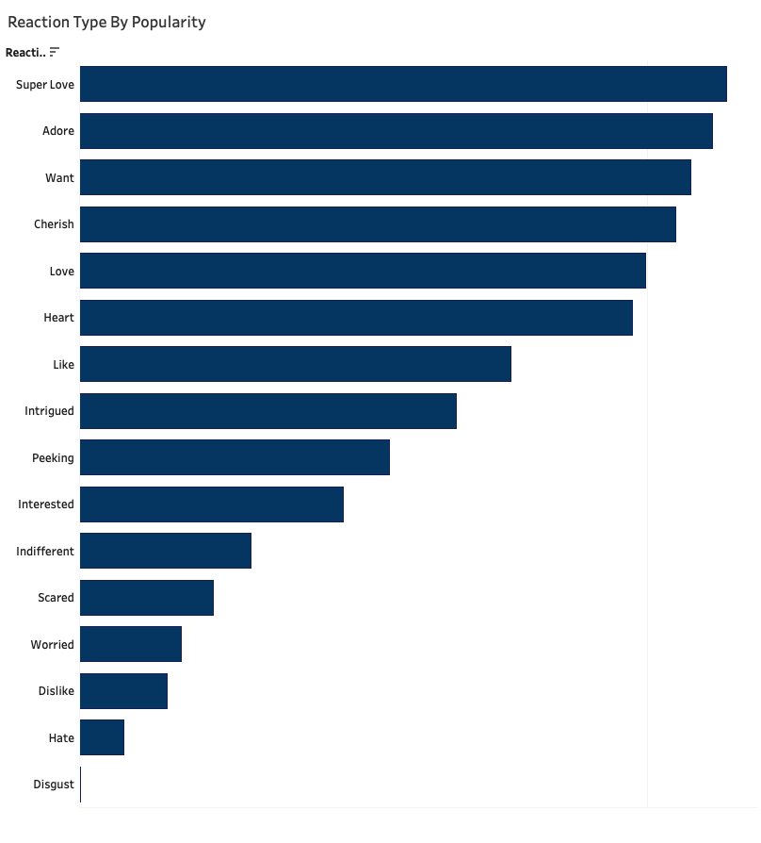
This chart shows the most widely used reaction type by popularity
Just as there are 16 categories, there are also 16 different types of reaction

Slide 9
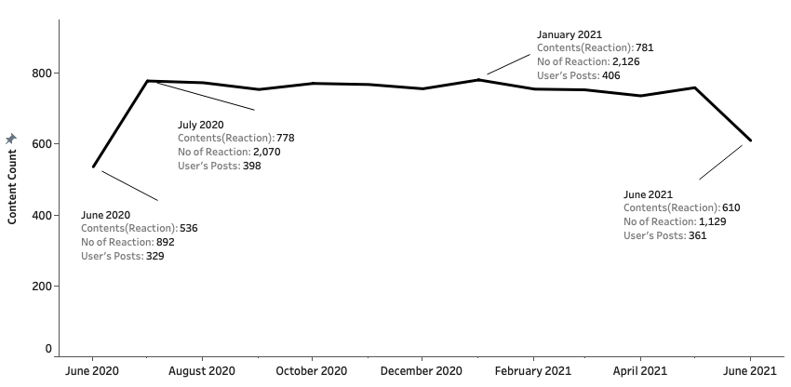
An overview of the Social Buzz contents between June 2020 and June 2021.
This chart shows that contents(posts) increases because users posts increased and vice versa.
It also shows that the more users made a post, the more the reaction given.
January 2021 had the highest number of contents reacted to.
June 2020 and 2021 had a low record compared to other months.

Slide 10
Social Buzz top five(5) content categories are; Animals, Science, Healthy Eating, Technology and Food. So you can drive your focus to these categories. More like running campaigns to boost engagements in these area.
There is neither a huge positive nor negative change in the reaction with contents.
But a fact is, from the previous slide, the more the users post on these top 5 content categories, the more reactions that will be given
The month of June recorded the lowest engagement twice. A more detailed analysis should be carried out to as why.
The top 5 categories are not just popular with negative thoughts around them but with more of positive thoughts.
To interact with the visuals, you can visit here: Social Buzz Dashboard
Conclusion

Slide 11
THANK YOU Any Questions?

